Slide 1
Group Project Group 18
Jack fuller
Ionuț ciobanu

Slide 2



Logline
Beat your opponent by destroying the blocks beneath you to get to the bottom of the screen before them.
2 players adversial
mobile strategy involved
turn based

Slide 3
Target audience
Age:
15 – 30
Gender:
Both males and females
Casual gamers

Slide 4
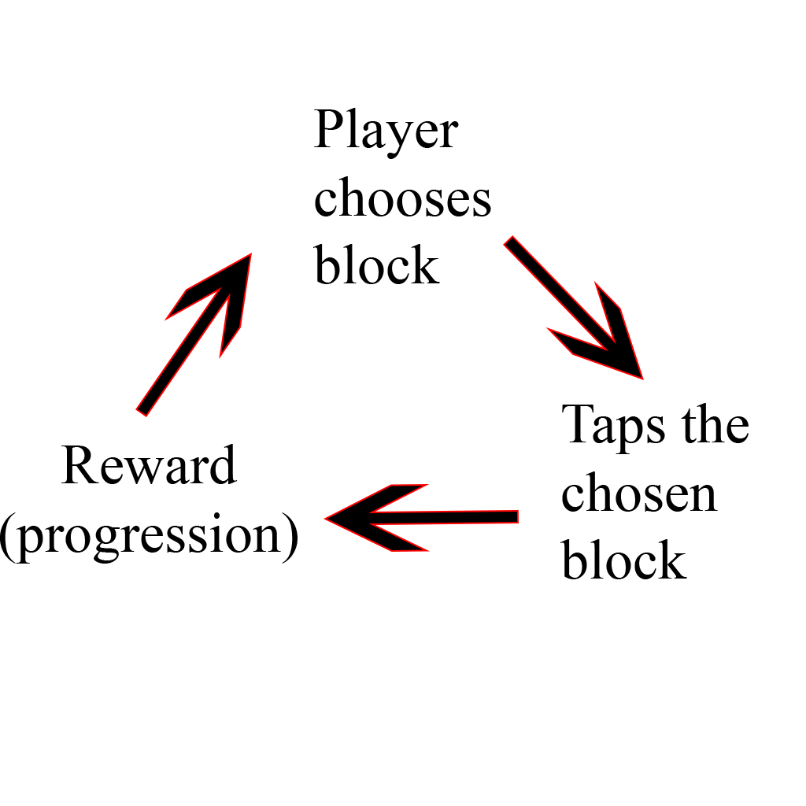
Core loop

Slide 5
Feedback
The score system wouldn’t make sense as the whole point of the game is to get to the bottom first.
Most of the players had no idea how the game works or what the combinations are respectively
The player starting the first had an advantage over the second player as he would be ahead from the beginning (closer to the bottom).

Slide 6
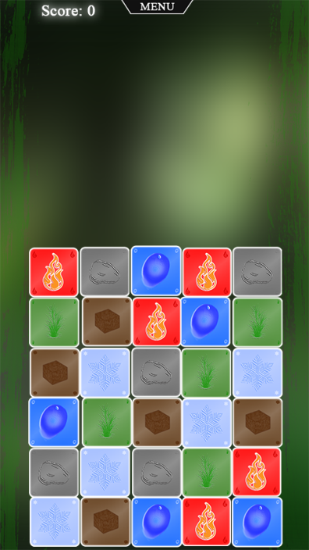
Iterations
The score system was removed as it wouldn’t have had any impact on the overall outcome of the game.

Slide 7
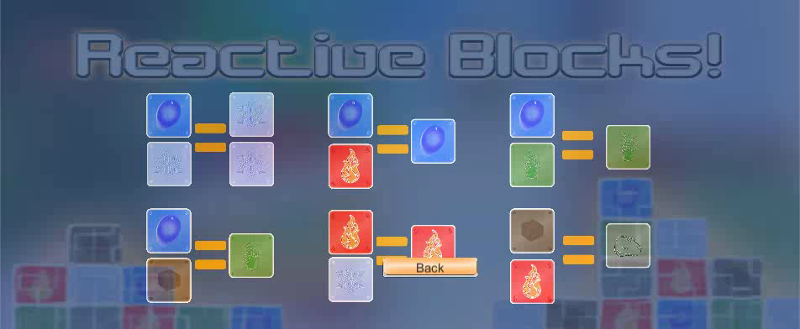
Iterations
2. Instruction screen presenting the available combinations was added => the players now had a rough idea about how the game should be played.

Slide 8
Iterations
3. Player 2 gets to start one row closer to the bottom in order to eliminate the handicap caused by the turn taking system.

Slide 9
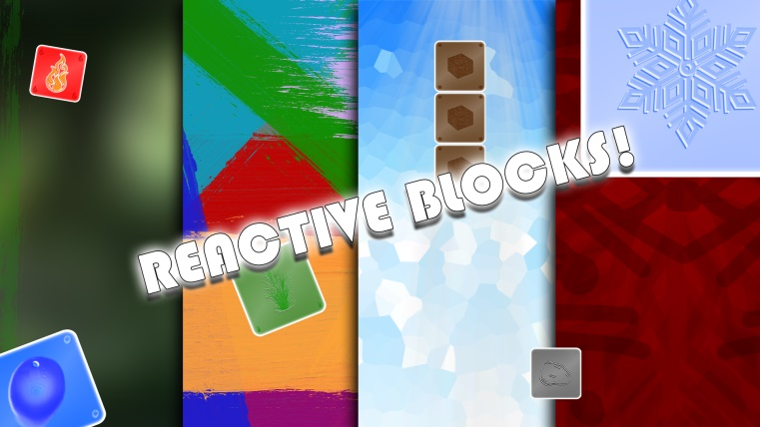
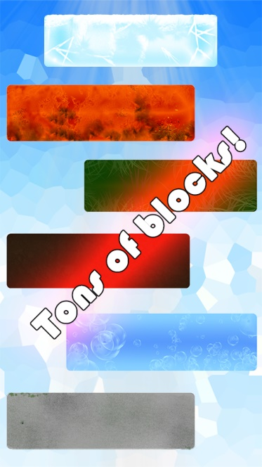

Slide 10
Key management lesson
A manager should focus more on taking the game oriented decisions collectively rather than on his own.
There are no irrelevant ideas as one idea that seems impractical can lead to a much better one.

Slide 11
Key Programming Lesson
A more understanding of code, when something did not work, found out why quicker than usual.
Another way to switch between scenes in unity.
More efficient ways of writing code and organising.

Slide 12
Key design lesson
Design decisions should be taken as a group rather than on your own, as they can have a big impact on the overall game experience.
One of the most important steps that every game project should go through is gathering feedback and iterating the game based on it.

Slide 13


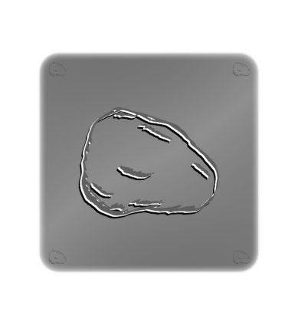

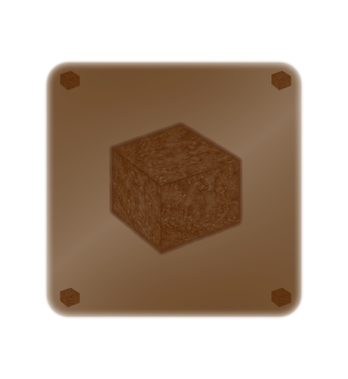
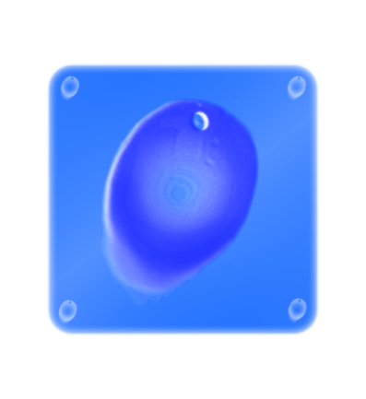
Game features
Combinations (reactions):
A set of 6 possible combinations players can use to get themselves closer to the bottom, thus winning the game.

Slide 14
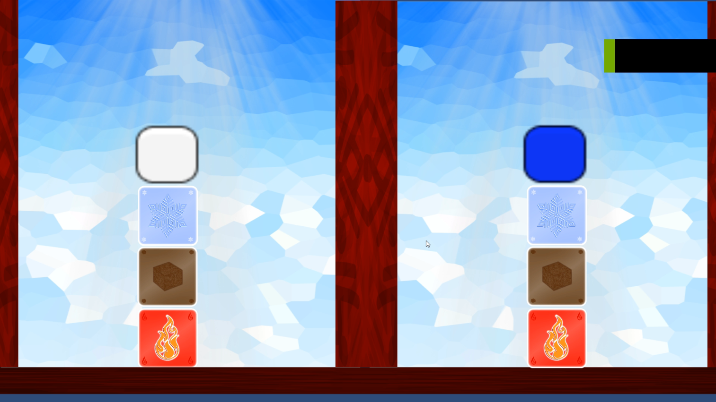
GAME FEATURES
2. Gravity – the game is based on blocks and characters that are affected by gravity.

Slide 15
Game features
3. Constant interaction (strategising):
You are able to tap on an individual block each turn in order to destroy it or launch a chain reaction between blocks.

Slide 16

QUESTIONS?

